Slide 1
DoodleDebug
better than toString()

Slide 2
Architecture
Default rendering for every (non-common) object type, i. e. rendering for type object

Slide 3
Architecture
Expandable:
Plugins for own data types
public class MyPlugin extends AbstractPlugin

Slide 4
Design process
Analyzing usage of printOn: in SqueakSource:
590 of 2145 projects override printOn: methods
(2688 printOn: methods)
77 % percent include own class name!
ASCII-graphics are made (e.g. for matrices)

Slide 5
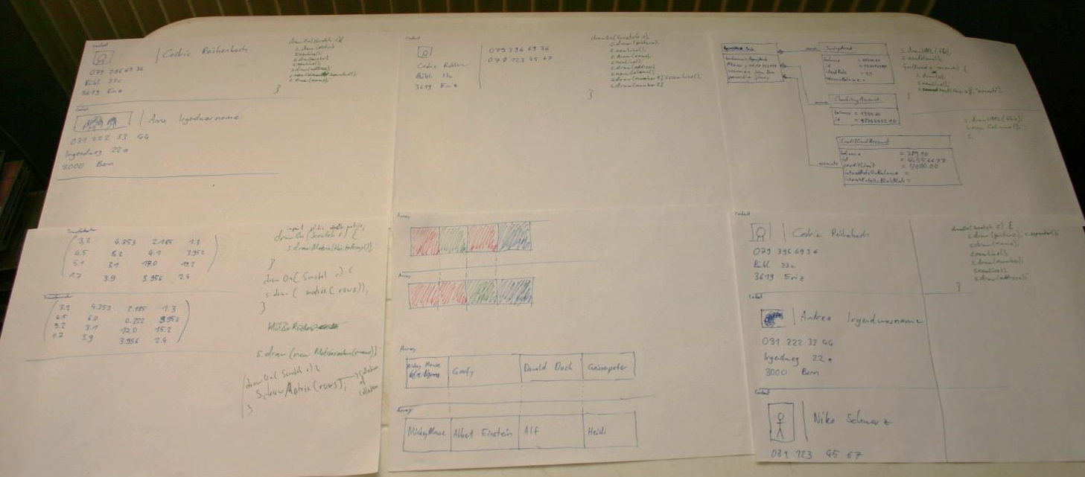
Design process
Sketching visualizations and
corresponding code snipplets

Slide 6
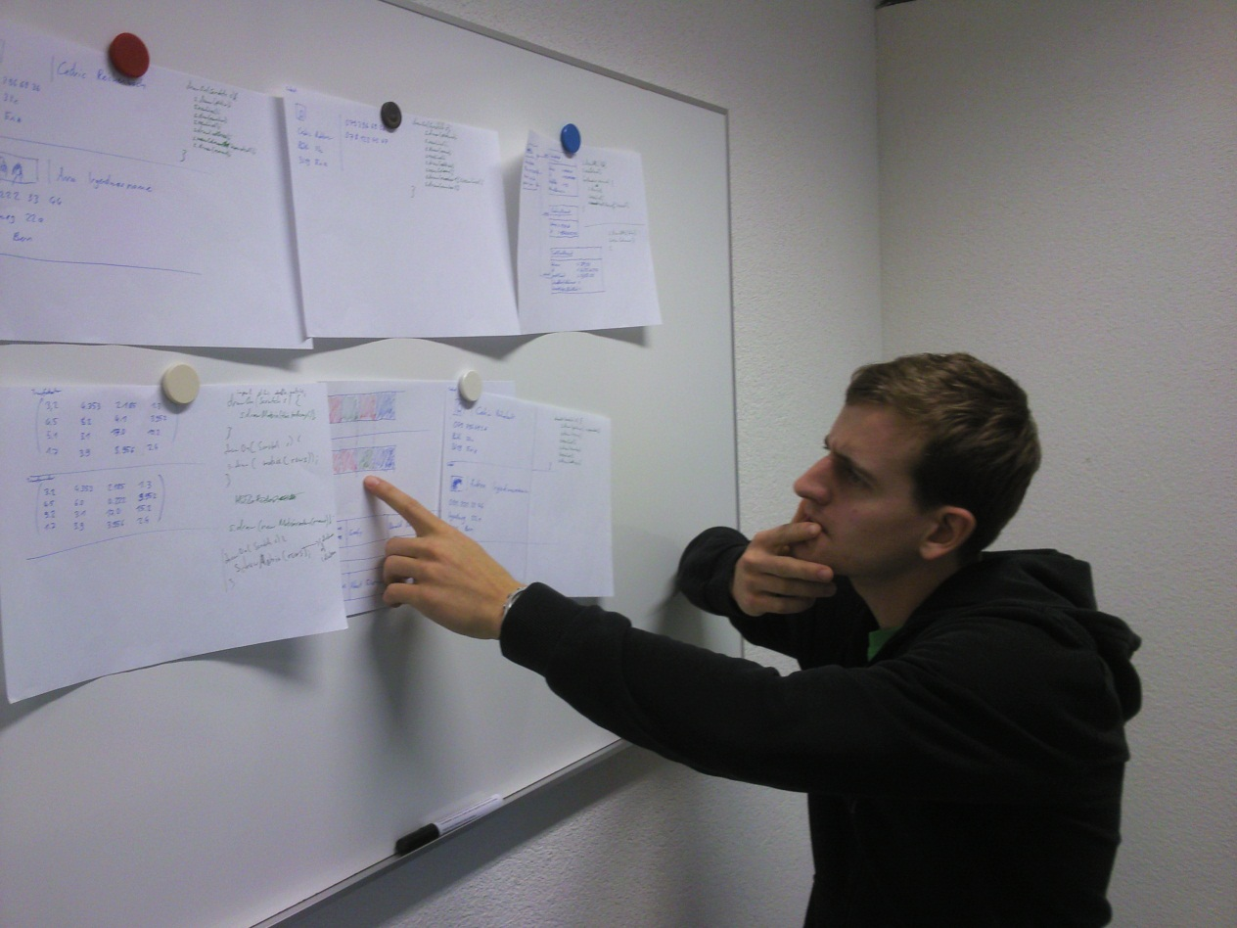
Design process
Talk to developers

Slide 7
Related work
Paper: «Let's go to the whiteboard: how and why software developers use drawings» main statement: Whiteboard → Computer Screen is too expensive

Slide 8
Related work
Zest: An Eclipse Visualization Toolkit, not debug-oriented, not very simple
DataDisplayDebugger: Graphical front-end for existing command-line debuggers
Moose

Slide 9
TODO:
More built-in renderings
Building Eclipse-Plugin
Use JavaScript to improve rendering (align corresponding components, semantic zooming)

Slide 10
Schedule
May 2012: Working Eclipse Plugin (& JavaScript)
July 2012: Paper finished
August 2012: Paper hand-in

